Slide 1
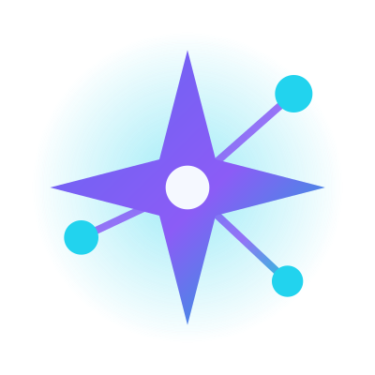
LumaNexus
Partner with Lumanexus.
Bring Polaris to schools.
Channel Partner Program - sell a trustworthy, board-aligned AI co-pilot that schools actually keep, and earn recurring commission on every school you sign.
15% first-year commission
Recurring on renewals
Co-branded kit + demo tenant
Polaris · Partner Program
Notes:
Partner with Lumanexus to bring Polaris, our AI teaching co-pilot, to schools. It's a product schools keep, with recurring commission for you on every school you sign.

Slide 2
THE OPPORTUNITY
A vast market, ready for trustworthy school AI
14.7 lakh
3.3 lakh
24.8 crore
~8.4 lakh
schools across India (UDISE+ 2023-24)
private schools - the paying beachhead
students, 98 lakh teachers nationwide
Karnataka SSLC students sit the board each year
Schools are under real pressure - teacher workload, board results, disconnected tools - and most "AI" on offer is a generic chatbot they can't trust in a classroom. Polaris is built for exactly this gap. (Validate local school counts for your territory.)
Polaris · Partner Program
Notes:
India has 14.7 lakh schools, 3.3 lakh of them private, serving 24.8 crore students. In Karnataka alone, about 8.4 lakh students sit the SSLC board every year. Schools are under pressure and most AI on offer is an untrusted chatbot. Polaris fills that gap.

Slide 3
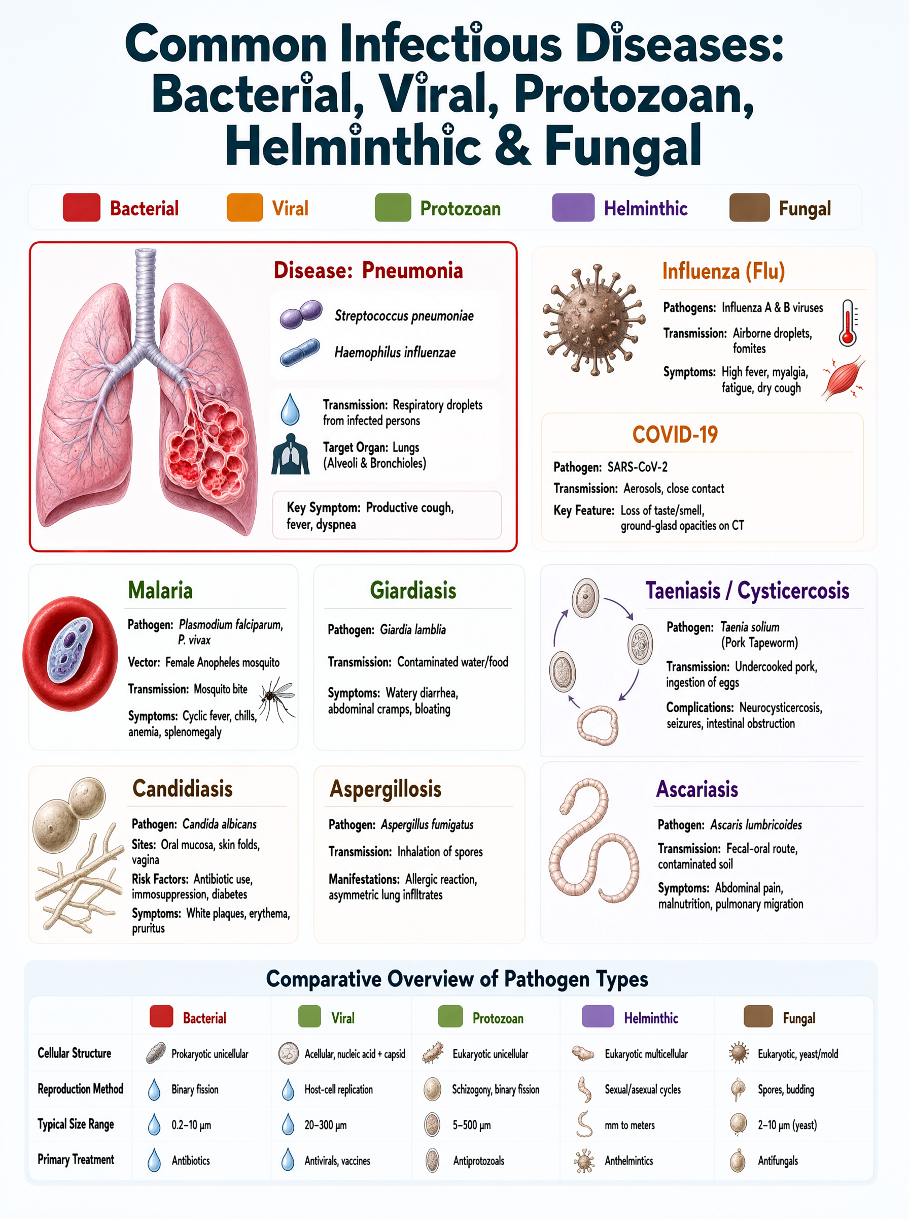
THE PRODUCT
Meet Polaris
An AI co-pilot for every teacher, a personal tutor for every student - grounded in the CBSE and Karnataka State Board syllabi.
Teaching Kit
A chapter's full teaching kit in minutes - lesson plan, worksheet, quiz, notes, mind map, deck.
Mission 625
Per-student board-exam improvement, measured to the KSEEB blueprint.
Nova + Aurora
A safe multilingual AI tutor, plus concept videos and visual content.
Polaris · Partner Program
Notes:
Polaris is an AI co-pilot for teachers and a tutor for students, grounded in the CBSE and Karnataka boards. Three pillars: the Teaching Kit builds a chapter's materials in minutes; Mission 625 drives measurable board-exam improvement; and Nova plus Aurora add a safe tutor and rich visual content.

Slide 4
WHY IT SELLS
Solves a real, daily pain - and schools keep it
THE PAIN
WHY POLARIS WINS
Teachers are overwhelmed
Grounded & checked
Hours lost each week building materials by hand.
Official textbooks, accuracy-gated - not a chatbot.
Board results matter
Board-aligned & multilingual
SSLC and board outcomes ride on every student.
CBSE / KSEEB, in English, Hindi and Kannada.
Tools don't talk
Child-safe & private
Content, assessment, tutoring, parents - all siloed.
Guardrails on every path; data isolated per school.
Polaris · Partner Program
Notes:
Polaris solves a daily pain: overwhelmed teachers, board pressure, and disconnected tools. And it wins on trust, because it's grounded in official textbooks, accuracy-checked, board-aligned, multilingual, child-safe and private per school. That's why schools keep it, which means recurring revenue for you.

Slide 5
PARTNER ECONOMICS
Recurring commission on every school
Commission structure
First-year commission per school
First-year licence
15%
Starter (Rs.90,000)
Rs.13,500
Renewals (every year)
10%
Standard (Rs.1,50,000)
Rs.22,500
Credit top-ups
5%
Premium (Rs.2,50,000)
Rs.37,500
Referral or reseller - you choose how to transact.
Plus 10% every year they renew - income that compounds.
Example: sign 10 schools on the Standard plan -> Rs.2,25,000 in first-year commission, plus about Rs.1,50,000 / year recurring as they renew.
Polaris · Partner Program
Notes:
You earn 15% on the first-year licence, 10% on every renewal, and 5% on credit top-ups. That's 13,500 to 37,500 rupees per school in year one depending on tier, plus recurring renewal income. Sign ten Standard schools and that's 2.25 lakh up front, plus around 1.5 lakh a year recurring.

Slide 6
HOW WE WORK TOGETHER
Two ways to partner
Referral
Reseller
- You introduce the school; we invoice and support.
- Simplest to start; no billing overhead for you.
- You earn commission on every licence and renewal.
- You invoice the school directly and bundle services.
- More margin and control; you own the relationship.
- Best for established school ERP / IT resellers.
Fair rules for everyone: register a school and it's yours for 90 days. Territory and targets agreed up front. You handle first-line onboarding; we handle L2/L3 and academic quality.
Polaris · Partner Program
Notes:
Two models. Referral: you introduce the school, we invoice and support, you earn commission. Reseller: you invoice directly, bundle services, keep more margin. Either way, register a school and it's yours for 90 days, territory and targets are agreed up front, and we back you on L2 and L3 support and academic quality.

Slide 7
YOUR PARTNER KIT
Everything you need to sell
Demo tenant
Training & certification
Co-branded collateral
A seeded, isolated Polaris to demo live - build a chapter in minutes.
A short onboarding and demo script; certify before you sell.
Sales deck, school flyer, FAQ and explainer video - with your logo.
Pilot offer
Deal support
Clear pricing
A subsidised pilot you can extend, with graduation gates to paid rollout.
We join key demos and handle technical and academic questions.
Transparent tiers and a credits model you can quote with confidence.
Polaris · Partner Program
Notes:
You get a full partner kit: a live demo tenant, training and certification, co-branded collateral with your logo, a pilot offer you can extend, our support on key demos, and clear, transparent pricing you can quote with confidence.

Slide 8
HOW TO SELL
A simple, pilot-first playbook
1
2
3
4
Target
Show
Pilot
Roll out
Private schools and school groups - decision-maker is the principal or academic head.
Demo a real chapter built in minutes; let them feel the time saved.
Start a subsidised pilot with clear success gates - trust is earned, not claimed.
Graduate the pilot to a paid plan; expand grade by grade.
The pilot is the close: once a school sees its own chapters built and checked, the decision makes itself.
Polaris · Partner Program
Notes:
The playbook is simple and pilot-first. Target private schools and groups. Show a real chapter built in minutes. Start a subsidised pilot with clear success gates. Then graduate it to a paid plan and expand grade by grade. The pilot is the close - once a school sees its own chapters built and checked, the decision makes itself.

Slide 9
BECOME A PARTNER
Let's bring trustworthy AI
to schools together.
Tell us your region and the schools you reach. We'll set up your demo tenant, certify your team, and hand you the kit - so you can start selling in weeks, not months.
Become a partner · hello@lumanexus.tech
www.lumanexus.tech
Polaris · Partner Program
Notes:
Ready to partner? Tell us your region and the schools you reach. We'll set up your demo tenant, certify your team, and hand you the kit, so you can start selling in weeks. Email hello@lumanexus.tech.

